Slide 1
Rockbuster: Insightful statistics

Slide 2
Agenda
For this presentation we will delve into some insightful statistics about Rockbuster’s global customer base and film preferences.
Our analysis will help us understand where our customers are located, which regions are most profitable, and identify key customers who significantly contribute to our revenue.

Slide 3
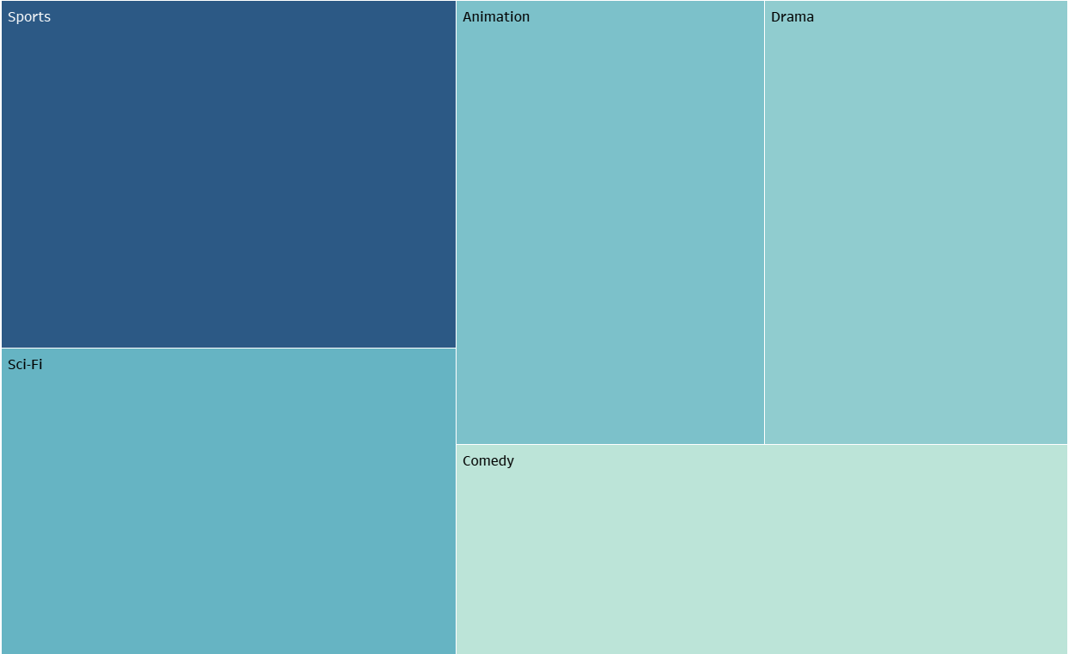

Overview of customer base and film data
We have 599 active customers in our database.
Most movies in our inventory are PG-13.
“Bucket Brotherhood” is our top rented movie by customers.
The average payment amount per customer is $4.20.
Top 5 Genres by Rental Amounts
This overview sets the stage for understanding our audience and their preferences, which is crucial for targeted marketing and content acquisition.

Slide 4
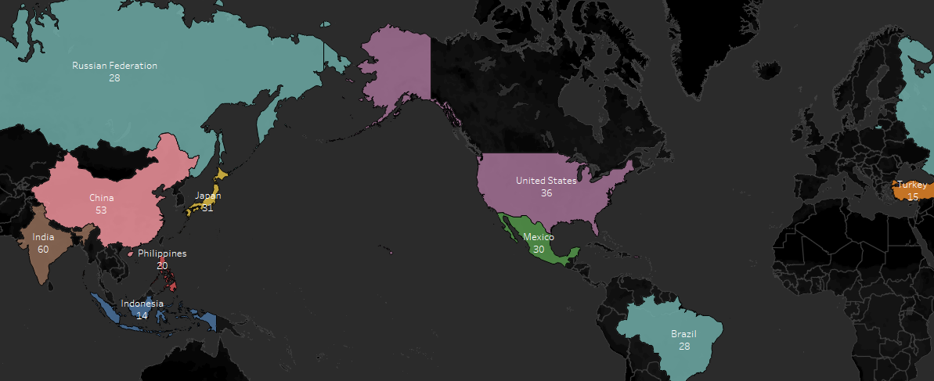
Top 10 countries by customer count
India: 60 customers
China: 53 customers
United States: 36 customers
Japan: 31 customers
Mexico: 30 customers
Brazil: 28 customers
Russian Federation 28 customers
Philippines: 20 customers
Turkey: 15 customers
Indonesia: 14 customers

Slide 5
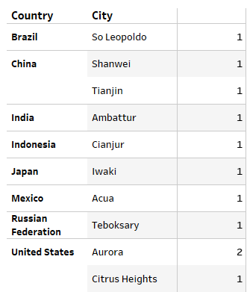
Top 10 cities within the top 10 countries by customer count
Aurora, United States has 2 customers in that city. The rest of the top 10 cities only have one customer.
The United States and China have customers in two cities, so these areas are a good starting target for regional promotion and advertisement.
Customer Count

Slide 6
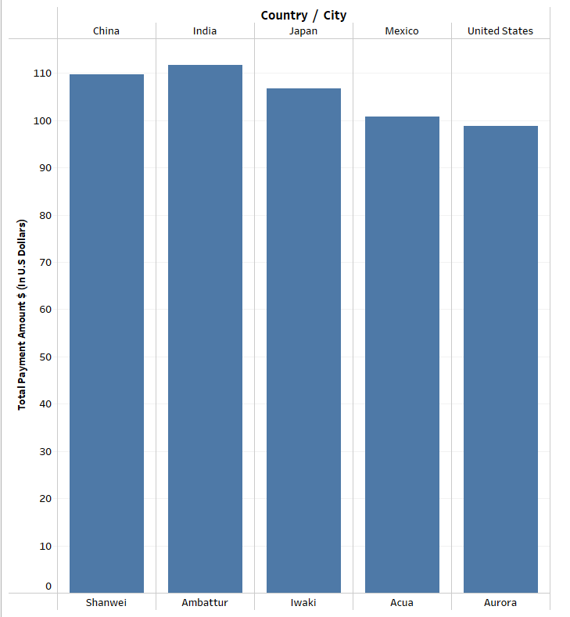
Top 5 customers by payment in each city
These high-value customers are crucial to our revenue streams.
Understanding their preferences can help us enhance their experience and possibly offer tailored promotions to retain them

Slide 7
Summary & conclusion
Summary:
Our top customers are located in:
Ambattur, India
Shanwei, China
Iwaki, Japan
Acua, Mexico
Aurora, United States
The top rented genres are: Sports, Sci-Fi, Animation, Drama, and Comedy
Our analysis highlights key markets and high-value customers. By focusing on the top countries and cities, we can tailor our marketing efforts and content offerings to better meet regional demands.
Additionally, recognizing our top customers and their spending patterns allows us to implement targeted retention strategies.

Slide 8
THANK YOU
Ariel Johnson
arielreese33@gmail.com​
Tableau Link: RockBuster SQL Visualizations

